Slide 1
Fetch-Decode-Execute Cycle

Slide 2
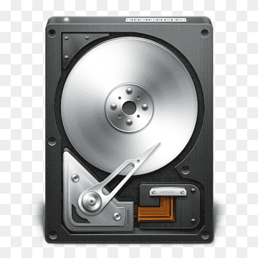

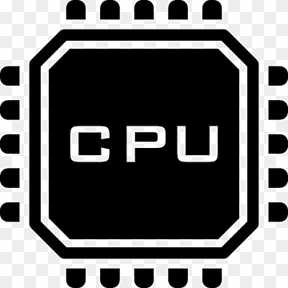

Program Execution
The Operating System will load the program from the disk into main memory
The CPU will read the program instructions and execute them one-by-one

Slide 3

Fetch-Decode-Execute
Step 1: Fetch instruction
Step 2: Decode instruction
Control Unit
System Bus
Arithmetic and Logical Unit (ALU)
Step 4: Store results
Step 3: Execute instruction

Slide 4
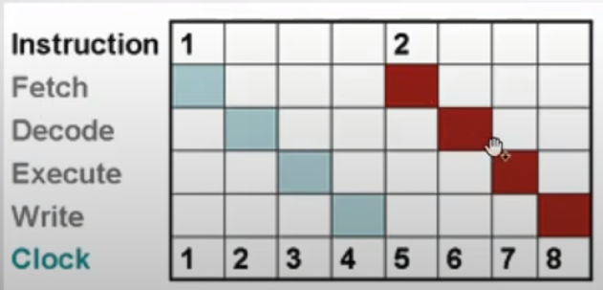
Instructions and Clock Cycles
One instruction ≠ One clock cycle, One instruction = Many clock cycles
Example: mov reg, reg/memory/constant instruction
Fetch the instruction byte from memory (one clock cycle)
Update the IP register to point at the next byte (one clock cycle)
Decode the instruction to see what it does (one clock cycle)
If required, fetch a 16-bit instruction operand from memory (0 or more clock cycles)
If required, update IP to point beyond the operand (0 or 1 clock cycle)
Compute the address of the operand, if required (i.e., bx+xxxx) (0-2 clock cycles)
Fetch the operand (one clock cycle)
Store the fetched value into the destination register (Execute) (1-3 clock cycles)

Slide 5
The Little Man Computer
https://peterhigginson.co.uk/lmc/ or https://www.101computing.net/LMC/

Slide 6
Program to Accept User Input
Accept an input from the user and will display it back to the user
INP
STA 20
OUT
HLT

Slide 7
Same Program, this time User Input Stored in a Variable without specifying a Memory Location
INP
STA A
OUT
HLT
A DAT

Slide 8
Store one input in a variable, another at an address
INP
STA A
INP
STA 20
LDA A
OUT
LDA 20
OUT
HLT
A DAT

